Slide 1
Software Testing
Introduction
Notes:
https://www.onlinequizcreator.com/software-testing/quiz-220011

Slide 2
Structure of the Module
Introduction to Testing
The Principles of Software Testing
Static Verification
Black Box Software Testing – Methods and Examples
White Box Software Testing – Methods and Examples

Slide 3
Structure of the Module
Integration testing
System testing
Testing in the Software Process

Slide 4
Textbook
Software Testing – Principles and Practice by S. Brown, J. Timoney, T. Lysaght and D. Ye, China Machine Press

Slide 5
What is Software?
  It is not just about computer programs
  It is also associated with documentation and configuration data that is needed to make these programs operate correctly

Slide 6
Define a Software System
A software system usually consists of a number of:
  instructions within separate programs that when executed give some desired function
  data structures that enable the programs to adequately manipulate information
  configuration files which are used to set up these programs
  system documentation which describes the structure of the system
  user documentation which explains how to use the system and web sites for users to download recent product information

Slide 7
Challenges of Software Systems
  Major challenges in building a software system:
    Effort intensive (organize carefully)
    High cost (if there is failure then the investment is lost)
    Long development time
    Changing needs/requirements for users
    High risk of failure
      user acceptance – may reject it
      Performance
      maintainability…

Slide 8
Quality and Software
There are risks associated with Software Development
Modern programs are complex and have thousands of lines of code
The customer’s requirements can be vague, lacking in exactness
Deadlines and budgets put pressure on the development team

Slide 9
Quality and Software
The combination of these factors can lead to a lack of emphasis being placed on the final quality of the software product
Poor quality can result in software failure resulting in high maintenance costs and long delays before the final deployment
The impact on the business can be loss of reputation, legal claims, decrease in market share

Slide 10
Quality and Software
The International Standard ISO 91261 Software Engineering – Product Quality is structured around six main attributes
These can be measured using a mix of objective and subjective metrics

Slide 11
ISO 91261 Attributes
Functionality | Suitability, accurateness, interoperability, compliance, security
Reliability | Maturity, fault tolerance, recoverability
Usability | Understandability, learnability, operability
Efficiency | Time behavior, resource behavior
Maintainability | Analysability, changeability, stability, testability
Portability | Adaptability, installability, conformance, replaceability

Slide 12
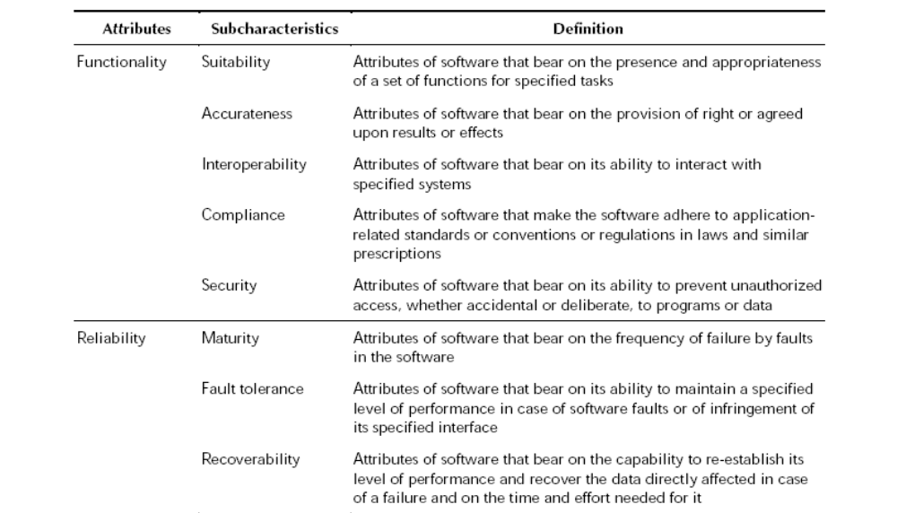
Detailed Description

Slide 13
Early Days of Software – Hardware Engineering
In the early days of computing, computer-based systems were developed using hardware-oriented management
Project managers focused on hardware
Project managers applied the controls, methods, and tools that we recognize as hardware engineering

Slide 14
Early Days of Software -The programmer
Programming was viewed as an art form
The programmer often learned his craft by trial and error
The software world was undisciplined

Slide 15
The Crisis in Software Engineering
In the 1970’s there were a number of problems with software:
  Projects were running over-budget
  Projects were running over-time
  The Software products were of low quality
  The Software products often did not meet their requirements
  Projects were chaotic
  Software maintenance was very difficult

Slide 16
Software Engineering
The actual term ‘software engineering’ was first proposed as far back as 1968 at a conference held to discuss what was then called the ‘software crisis’.
It was becoming clear by then that individual approaches to program development did not scale up to large and complex software systems. These were unreliable, cost more than expected, and were delivered late.

Slide 17
Software Engineering
To overcome these problems throughout 1970s and 1980s, a variety of new software engineering techniques and methods were developed
These include structured programming, information hiding and object-oriented development.
Tools and standard notations that were developed at that time are now extensively used

Slide 18
Problems with Software
These can be broken down into three elements of Errors, Faults and Failures

Slide 19
Errors, Faults and Failures
Errors: these are mistakes made by software developers. They exist in the mind, and can result in one or more faults in the software.
Faults: these consist of incorrect material in the source code, and can be the product of one or more errors. Faults can lead to failures during program execution.
Failures: these are symptoms of a fault, and consist of incorrect, or out-of specification behaviour by the software. Faults may remain hidden until a certain set of conditions are met which reveal them as a failure in the software execution.

Slide 20
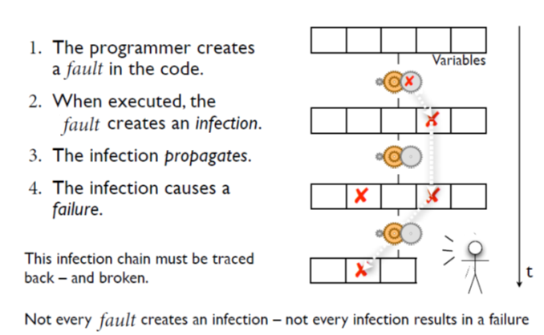
From Fault to Failure

Slide 21
Software Faults - Categories
Algorithmic faults
  Algorithmic faults are the ones that occurs when a unit of the software does not produce an output corresponding to the given input under the designated algorithm
Syntax Faults
  These occur when code is not in conformance to the programming language specification, (i.e. source code compiled a few years back with older versions of compilers may have syntax that does not conform to present syntax checking by compilers (because of standards conformity).

Slide 22
Software Faults - Categories
Documentation faults
  Incomplete or incorrect documentation will lead to Documentation faults
Stress or overload faults
  Stress or Overload faults happens when data structures are filled past their specific capacity where as the system characteristics are designed to handle no more than a maximum load planned under the requirements
Capacity and boundary faults
  Capacity or Boundary faults occur when the system produces an unacceptable performance because the system activity may reach its specified limit due to overload
Computation and precision faults
  Computation and Precision faults occur when the calculated result using the chosen formula does not confirm to the expected accuracy or precision

Slide 23
Software Faults - Categories
Throughput or performance faults
  This is when the developed system does not perform at the speed specified under the stipulated requirements
Recovery faults
  This happens when the system does not recover to the expected performance even after a fault is detected and corrected
Timing or coordination faults
  These are typical of real time systems when the programming and coding are not commensurate to meet the co-ordination of several concurrent processes or when the processes have to be executed in a carefully defined sequence

Slide 24
Software Faults - Categories
Standards and Procedure Faults
  Standards and Procedure faults occur when a team member does not follow the standards deployed by the organization which will lead to the problem of other members having to understand the logic employed or to find the data description needed for solving a problem.

Slide 25
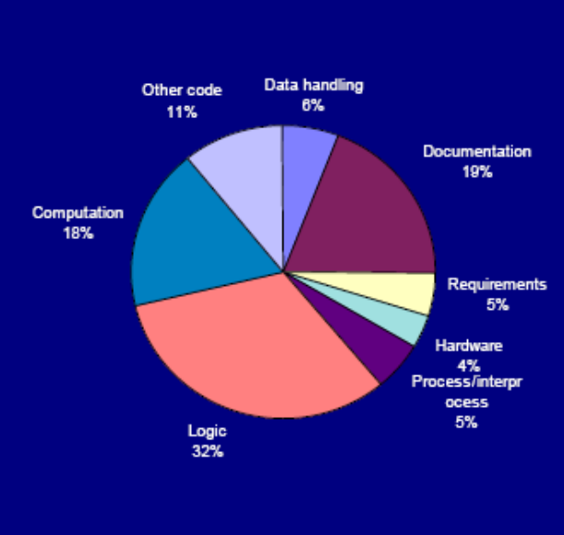
Software Faults
A study by Hewlett Packard on the frequency of occurrence of various fault types, found that 50% of the faults were either Algorithmic or Computation and Precision

Slide 26
Software Failures
Failure causes a system crash and the recovery time is extensive; or failure causes a loss of function and data and there is no workaround
Failure causes a loss of function or data but there is manual workaround to temporarily accomplish the tasks
Failure causes a partial loss of function or data where user can accomplish most of the tasks with a small amount of workaround
Failure causes cosmetic and minor inconveniences where all the user tasks can still be accomplished

Slide 27
Comparing Software with Hardware
To gain an understanding of SW and how to approach testing it, it is important to examine the characteristics of software that make it different from other things that human beings built.
When hardware is built, the human creative process (analysis, design, construction, testing) is ultimately translated into a physical form.
Software is a logical rather than a physical system element.
Therefore, software has characteristics that differ considerably from those of hardware

Slide 28
Difference between Software and Hardware
Software is developed or engineered, it is not manufactured in the classical sense.
Software does not wear out
See failure curves for hardware and software
Most software is custom-built, rather than being assembled from existing components

Slide 29
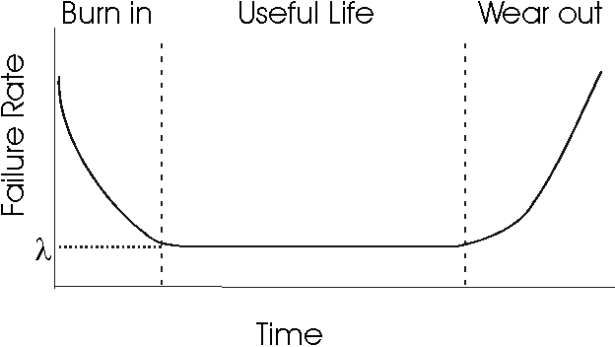
Failure Curve for Hardware
Burn-in: Procedure used in spotting weak parts or circuits of an electronic device (such as a computer) by running it at full power in a hot and humid environment for extended periods (up to 30 days for critical systems). This practice is based on the experience that semiconductor devices often show their defects in the first few days or weeks of operation.

Slide 30
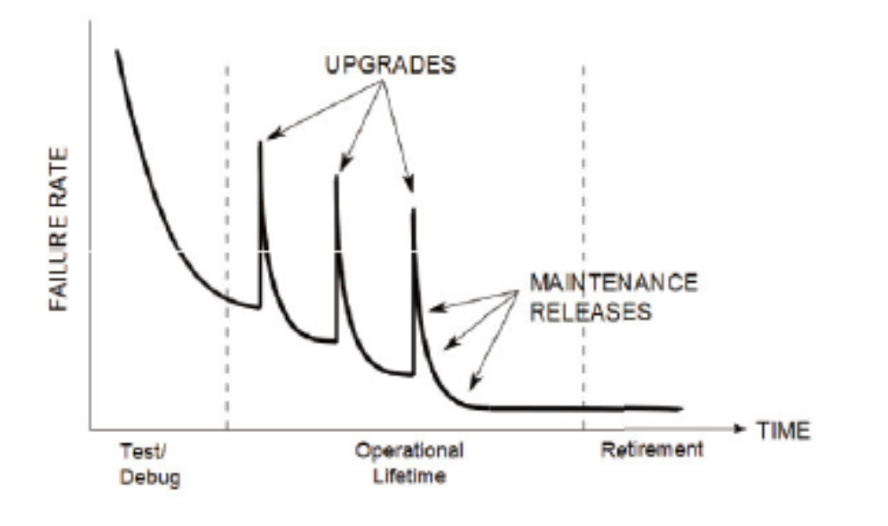
Curve for Failure Rate over Product lifecycle

Slide 31
Curve for Failure Rate over Product lifecycle
Unlike hardware software does not physically wear out.
It is subject to ongoing changes after release and is subject to changes in the external environment (such as an OS upgrade).
These changes can introduce new faults or expose latent faults.

Slide 32
Curve for Failure Rate over Product lifecycle
Initially, the first version has a high failure rate. With debugging and testing, as these are found and corrected the failure rate decreases until it reaches an acceptable level.
Upgrades introduce new faults that are then fixed via maintenance releases
Once the software is no longer supported the failure rate levels off until the product becomes obsolete.

Slide 33
Difficulties with Software vs Hardware
It is difficult for a customer to specify requirements completely.
It is difficult for the supplier to understand fully the customer needs.
In defining and understanding requirements, especially changing requirements, large quantities of information need to be communicated and assimilated continuously.
Software is easy to change.
Software is primarily intangible; much of the process of creating software is also intangible, involving experience, thought and imagination.
It is difficult to test software exhaustively

Slide 34
Forward Engineering
This is an approach to designing correct systems. It starts with the user and ends with the correct implementation. The end product matches the specification.

Slide 35
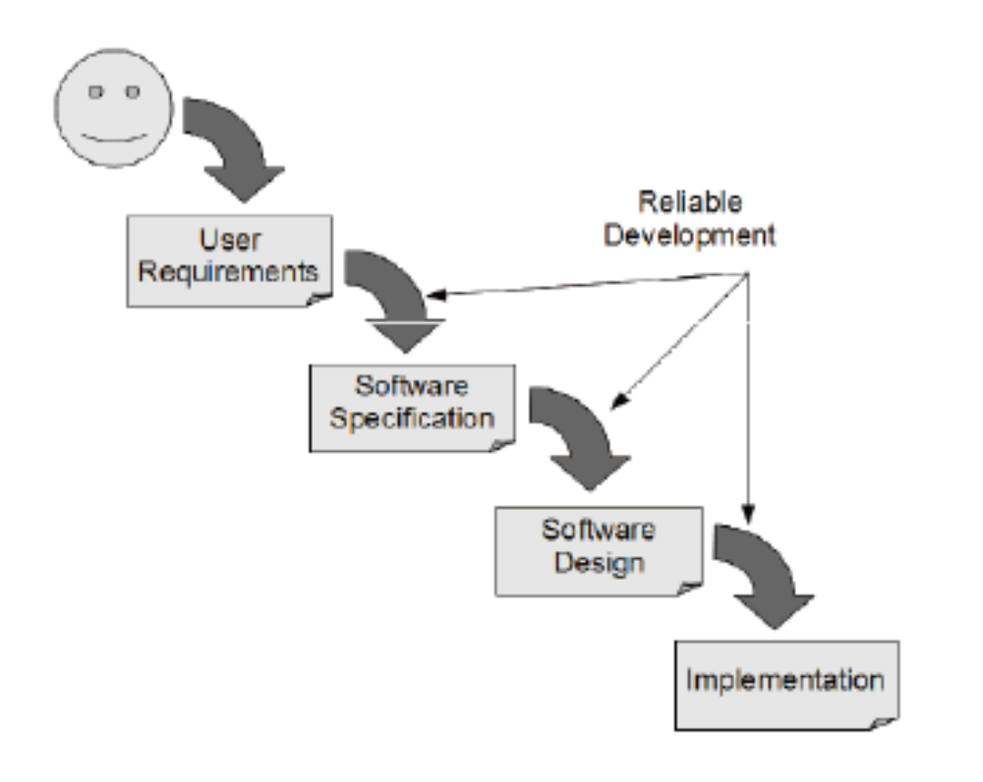
Forward Engineering

Slide 36
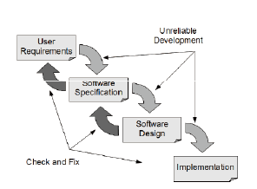
Check and Fix
In practice, all development steps must be subject to a check to ensure it has
been carried out properly and any mistakes encountered are fixed.

Slide 37
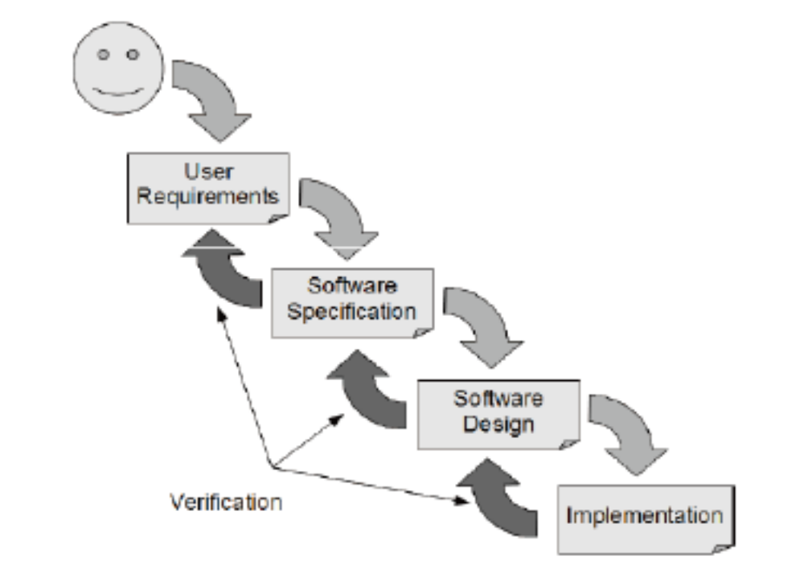
Including verification in the development process
Check that each step meets its specifications

Slide 38
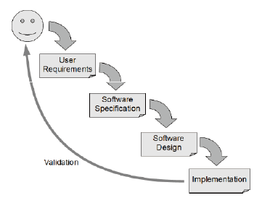
Validation in the development process
Check that the software meets the users needs

Slide 39
Specifications
Specifications play a key role. Detailed specifications provide the correct behaviour of the software.
They must describe normal and error behaviour.

Slide 40
Testing in the development process
Software has three key characteristics
– User requirements that state the user’s needs
– A functional specification stating what the software must do
– A number of modules that are integrated to form the final system
These must be verified using the following four test activities

Slide 41
Unit Testing
An individual unit of software is tested to ensure that it works correctly. This may be a single component or a compound component.
A component might be a method, a class, or subsystem. It could be a single GUI component (e.g. button) or a collection of them (e.g. a window).
This makes use of the programming interface of the unit.

Slide 42
Integration Testing
Two or more units are tested to ensure that they interoperate correctly.
This may use the programming interface or the System interface.
Can be Top-Down, Bottom-up, or take an ‘end-to-end user functionality’ approach

Slide 43
System Testing
The entire software system is tested to make sure that it works correctly and that it meets/solves the user’s needs/problem.
This uses the system interface which may be a GUI, Network interface, web interface etc…

Slide 44
Acceptance Testing
The entire software system is tested to make sure that it meets the user’s needs.
Again, this uses the system interface.

Slide 45
Object
Design
Document
System
Design
Document
Requirements
Analysis
Document
Client
Expectation
Unit
Testing
Integration
Testing
System
Testing
Acceptance
Testing
Developer
Client

Slide 46
Regression testing
Regression testing is a form of software testing that confirms or denies a software’s functionality after the software undergoes changes.
make new regression tests as you find and correct bugs
Ensure that you don’t reintroduced errors that were previously fixed

Slide 47
Regression Testing practice
Maintain a Strict regular Testing Schedule
Use Test Management Software
Categorize Your Tests so they are easily understood
Prioritize Tests based on need, e.g. customer’s requirements

Slide 48
Theory of Testing
The goal is to identify the ideal test – that is, the minimum test data required to ensure that the software works for all inputs.

Slide 49
Exhaustive Testing
This is generally not feasible as it would take too long or require too much memory space.
• A good test should have a high probability of finding faults, not duplicate another test, be independent in what it measures so no faults conceal one another, and test as much of the code as possible.

Slide 50
Exhaustive Testing Example
Consider a method bound() as defined below:
  // return a value of x bounded by the upper and lower values
  // return lower if x<=lower
  // return upper if x>=upper
  // return x if lower<x<upper
  long bound(int lower, int x, int upper);

Slide 51
Exhaustive Testing Example
If int is defined as a 32-bit, signed integer, then each input parameter has 2³² possible input values.
Exhaustive testing would require using every possible combination of input values, leading to 2⁹⁶ tests.
If, on average, each test took 1 nano-second to execute – possible on a modern, multi-core processor – then the test would take 2⁹⁶ (or about 10²⁹) nano-seconds to complete. This is approximately 10¹² years!
The sun is only 4.6 ∗ 10⁹ years old. So clearly this is not feasible, even for a simple function.

Slide 52
Time Spent on Testing
50%~Brooks/Myers, 1970s
80%~Arthur Andersons’ Director of testing in North America, 1990s

Slide 53
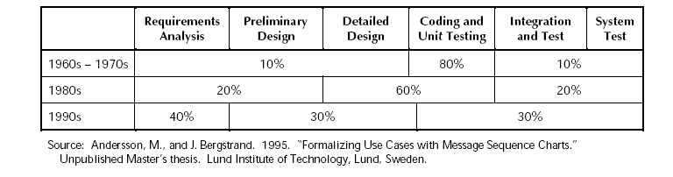
Time Allocation to create Software

Slide 54
Time Allocation to create Software
Since the 1970s, software developers began to increase their efforts on requirements analysis and preliminary design, spending 20 percent of their effort in these phases.
More recently, software developers started to invest more time and resources in integrating the different pieces of software and testing the software pieces as units rather than as a complete entity
Effort spent on determining the developmental requirements has also increased in importance, with 40% of software developers effort now happening in the requirements analysis phase

Slide 55
Time Spent on Testing
 | Planning | Code & Unit Test | Integration & Test
Commercial DP | 25% | 40% | 35%
Internet Systems | 55% | 15% | 30%
Real-time Systems | 35% | 25% | 40%
Defense Systems | 40% | 20% | 40%
DP: Desktop Publishing
Bennatan, E.M, “On Time Within Budget”, 2000

Slide 56
Time Spent on Testing
Activity | Small Project (2.5K LOC) | Large Project (500K LOC)
Analysis | 10% | 30%
Design | 20% | 20%
Code | 25% | 10%
Unit Test | 20% | 5%
Integration | 15% | 20%
System test | 10% | 15%
McConnell, Steve, “Rapid Development”, 1996

Slide 57
Testing Types
Black-box testing – generate input values that exercise the specification and compare the actual output with the expected output
White-box testing – generate input values that exercise the implementation and compare the actual output with the expected output
Fault insertion – insert faults into the code or data to measure the effectiveness of testing or ensure that the fault is detected and handled correctly

Slide 58
Finishing Testing
A budgetary point of view: when the time or budget allocated has expired
An activity point of view: when the software has passed all of the planned tests
A risk management point of view: when the predicted failure rate meets some quality criteria

Slide 59
Criteria
Usage-based criteria give priority to the most frequent sequences of program events.
Risk of Release predicts the cost of future failures based on their chance of occurring.

